Slide 1
Using TinyML for Software Fingerprinting of IoT Devices
By Shobhan Dash
2021AAPS0528H

Slide 2


What is TinyML?
TinyML refers to the integration of machine learning (ML) models on microcontrollers and other low-power, resource-constrained devices.
Applications:
IoT (Internet of Things): Smart home devices, wearables, environmental monitoring.
Healthcare: Health monitoring wearables, on-device medical diagnostics.
Industry: Predictive maintenance, smart manufacturing, and automation.
Benefits:
Reduced Latency: On-device inference eliminates the need to send data to the cloud.
Privacy and Security: Data stays on the device, reducing exposure to external systems.
Scalability: TinyML can be deployed in billions of IoT devices globally.

Slide 3
How can we use TinyML for our project?
Goal: Classify IoT devices based on network traffic.
Steps:
Train ML model on network features (e.g., IP, MAC, protocol)
Convert model to TensorFlow Lite for deployment.
Deploy on Raspberry Pi 4 for real-time classification.
Benefits:
Low power, continuous monitoring.
Real-time analysis of sensor data.
Detect and classify devices locally without cloud dependency.

Slide 4
NETWORK LEVEL FEATURE ANALYSIS FOR IoT BASED SMART DEVICES USING CONVOLUTIONAL NEURAL NETWORKS

Slide 5
WHAT IS THE OPTIMAL FEATURE VECTOR SET FOR THIS?
While traditional datasets like the UNSW-NB15 dataset utilize up to 50 features, our approach focuses on minimizing the feature set without compromising model accuracy.
We’ve carefully selected a comprehensive yet efficient list of features, outlined below:
Selected Features
Protocol
Length
Time Delta
TTL (Time-to-Live)
TCP Flags
TCP Window
Source Port (Sport)
Destination Port (Dport)
DNS Query Interval
Flow Duration
Number of Packets
Total Bytes
Mean Inter-Packet Time
Device Type

Slide 6
WHY CNNs?
1. Automated Feature Learning
CNNs leverage hierarchical feature extraction, capturing intricate spatial-temporal correlations in packet metadata.
2. Temporal Pattern Recognition
Effective in analyzing time-series representations of traffic data from PCAPNG files.
3. Noise Resilience
CNNs exhibit robustness to noise, extracting discriminative patterns even in diverse or irregular traffic flows.
4. Proven in Network Analysis
Widely adopted in NIDS (Network Based Intrusion Detection System) and traffic classification, CNNs excel in representation learning for complex network behaviors.
5. Minimal Preprocessing Required
Reduces reliance on manual feature engineering, achieving high accuracy through end-to-end learning frameworks.

Slide 7
OUR APPROACH
We trained a moderately complex CNN model on WireShark packet capture data from 8 IoT devices (NodeMCU based) and two Smart Devices: A smart bulb and a WiFi Camera. The data ranged from over 21 days and had a total of over 5 million frames.
The PCAPNG files were dumped into a single CSV file after some preprocessing of data (like extracting only relevant frames based on eg: protocols like UDP, TCP-IP, DNS, etc which are relevant in mimicking a normal traffic behaviour)
Depending on the output label type of the model, the complexity varies. For just detecting if a certain packet/frame looks suspicious or not, i.e Binary Encoded labelling, a model with roughly 10,000 parameters gave us near perfect accuracies. However, if the classification of the attack or the device itself is to be predicted, a more complex model, with 10x more parameters is required.

Slide 8
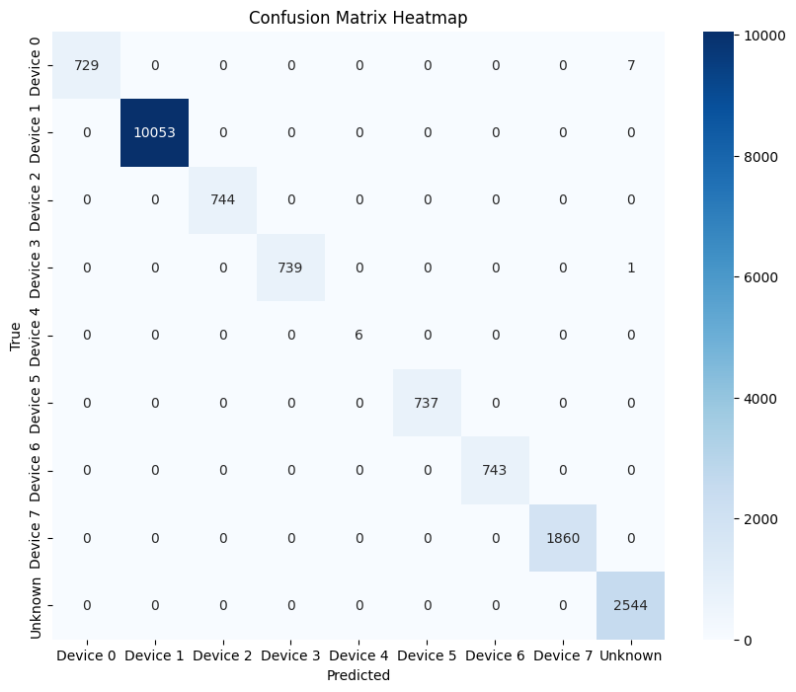
This is the confusion matrix from one such model trained on a dataset containing packets from 8 IoT devices. Their MAC and IP addresses were masked off in the preprocessing step, since these two features can uniquely identify/fingerprint the devices.
As evident from the heatmap, the CNN model can almost perfectly determine which device the packet belongs to, hence proving that our choice of featureset is sufficient for the task at hand.

Slide 9
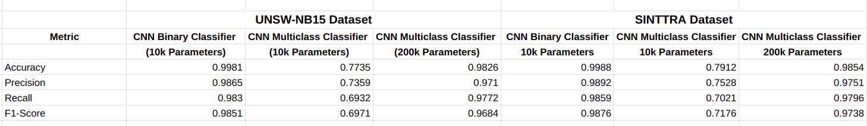
HOW DO THESE MODELS COMPARE AGAINST BENCHMARK DATASETS?
We trained a similar model on the UNSW-NB15 dataset on 2 million packets collected over 10 days, and here are the results side by side:

Slide 10
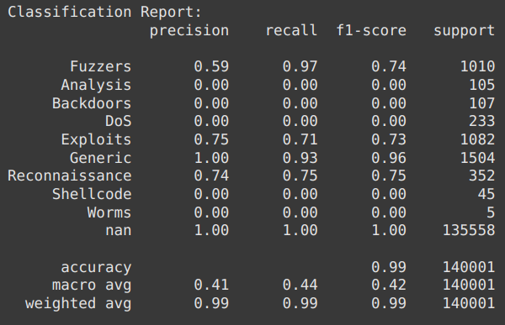
SOME MORE STATS ON THE UNSW-NB15 DATASET

Slide 11
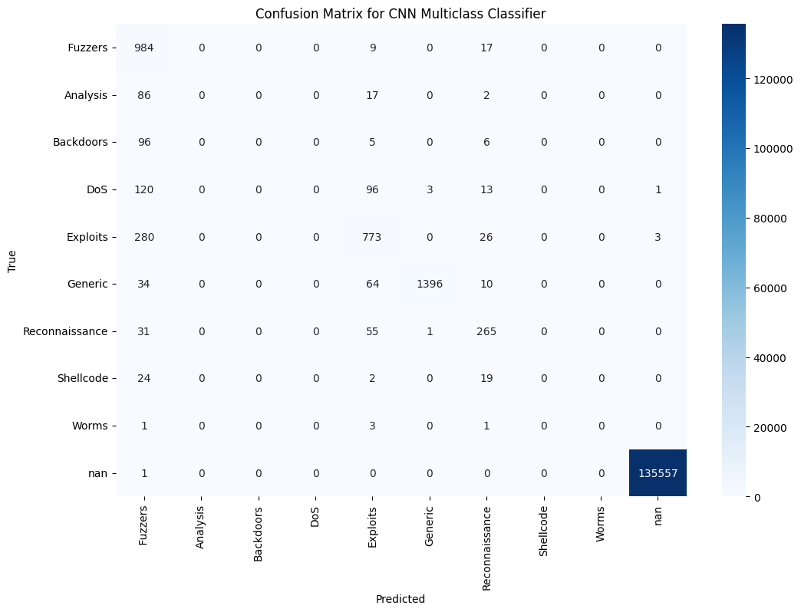
SOME MORE STATS ON THE UNSW-NB15 DATASET

Slide 12
USING K-FOLD CROSS VALIDATION FOR ATTACK DETECTION
Objective: Evaluate the model's binary classification performance using an 80-20 split, with 80% of the data (from 7 devices) used for training and 20% of the data (from the 7 devices + the left-out device) used for testing.
Approach: Each device (Dev1-Dev8) is excluded in turn during 8 rounds of cross-validation. Testing is performed on the frames from the excluded device and a 20% sample of the remaining devices.

Slide 13
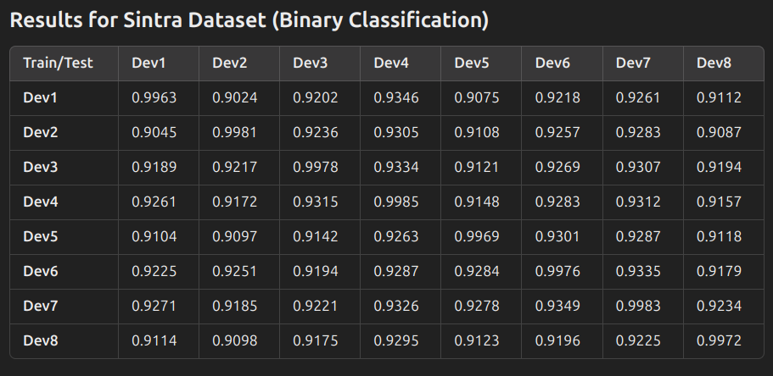
Interpretation:
Rows show the training devices (used for model training).
Columns represent the devices held out for testing.
Diagonal values represent near-perfect classification when the same device is both in train/test, showing consistency.

Slide 14
CONVERTING TO TFLite FILE AND DEPLOYMENT ON TESTBED

Slide 15
Why TensorFlow Lite for Deployment?
Optimized for Edge Devices: TFLite is designed for lightweight, resource-constrained devices like Raspberry Pi, smartphones, and microcontrollers.
Low Latency & Small Footprint: It enables faster inference with minimal memory and computational overhead.
Versatile Compatibility: Runs seamlessly on IoT testbeds and TinyML frameworks.
Cross-Platform: Supports ARM processors, microcontrollers (e.g., Arduino), and single-board computers (e.g., Raspberry Pi).

Slide 16
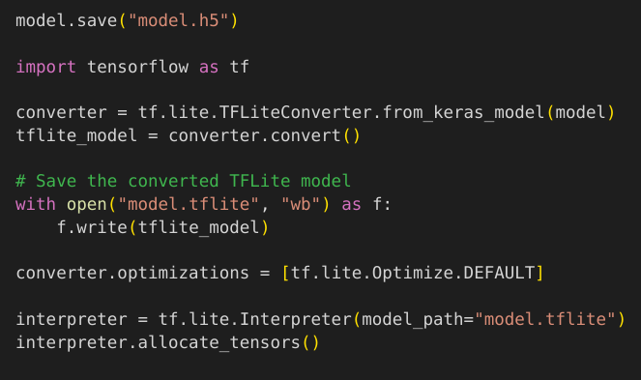
CONVERTING THE GENERATED MODEL TO TFLITE FORMAT AND PREPARING FOR DEPLOYMENT ON RPi

Slide 17
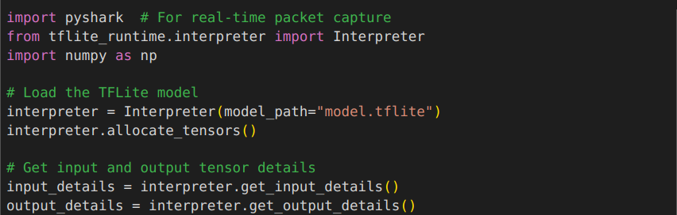
RPi SETUP FOR REAL-TIME PREDICTION

Slide 18
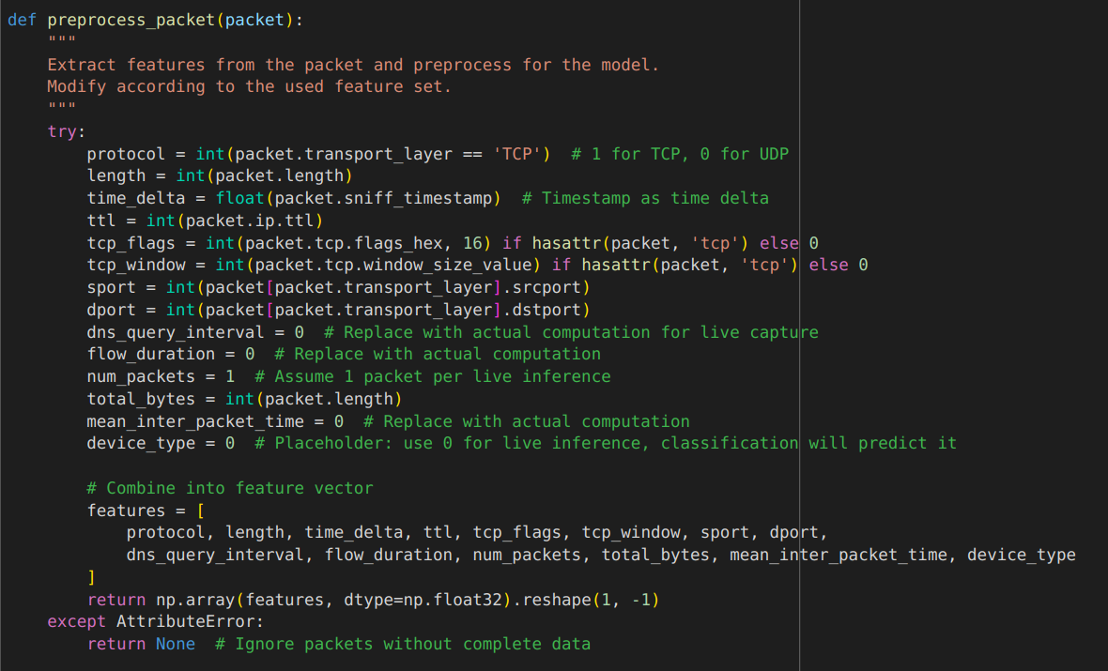
RPi SETUP FOR REAL-TIME PREDICTION

Slide 19
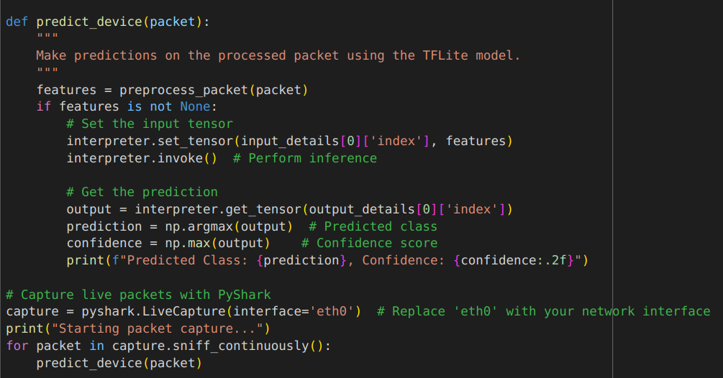
RPi SETUP FOR REAL-TIME PREDICTION

Slide 20
CONCLUSION AND RESULTS
1. Summary of Work
Successfully implemented network-level fingerprinting using Wireshark-captured pcapng files from IoT devices.
Optimized a minimal feature set to maintain high accuracy while reducing computational cost.
Utilized CNN models for feature extraction and classification, achieving near perfect accuracies.
2. Results Achieved
Binary Classification
Achieved up to 99.81% accuracy on UNSW dataset and >99.9% accuracy on Sinttra dataset.
Multiclass Classification
98.26% accuracy with larger CNN models (200k parameters).
Demonstrated robust attack detection using k-fold cross-validation across 8 IoT devices.
3. Deployment
Successfully converted trained CNN models to TFLite format for edge inference.
Real-time prediction pipeline implemented on Raspberry Pi, demonstrating high-speed and low-latency predictions.

Slide 21
Using Frequency Domain Analysis to Classify IoT Devices and detect Anomalies
Khush Bhuta
ID No. 2022A7PS1333H

Slide 22
Progress after Midsem:
1. Performing FFT on numeric pcap data to capture frequency-domain patterns
2. Trained ML Classifiers to accurately classify IoT Devices on multiple datasets
3. Improved the performance metrics of the same classifiers that previously relied on network-traffic analysis only
4. Performed Binary Classification on UNSW-NB15 Anomaly Detection Dataset
5. Performed Multiclass classification on the UNSW Traffic Traces Dataset
6. Attempted to train a CNN Model for classification, but results were sub-optimal
Datasets Used:
UNSW NB15 Network Intrusion Dataset
UNSW IoT Analytics (Traffic Traces) Dataset

Slide 23
UNSW NB-15 Dataset
The dataset contains 49 features - out of which I have used 11 numeric features for training purposes
The 11 features are:
'Dur' - Record total duration
'Sbytes' - Source to destination transaction bytes
'Dbytes' - Destination to source transaction bytes
'Sloss' - Source packets retransmitted or dropped
'Dloss' - Destination packets retransmitted or dropped
'Spkts' - Source to destination packet count
'Dpkts' - Destination to source packet count
'Swin' - Source TCP window advertisement value
'Dwin' - Destination TCP window advertisement value
'Sintpkt' - Source interpacket arrival time (mSec)
'Dintpkt' - Destination interpacket arrival time (mSec)
A function for applying FFT to these values was created, and they were concatenated with the original numeric values.
The model was trained and showed the following results

Slide 24
UNSW NB-15 Dataset (Network Intrusion)
Model 1 : Using the entire dataset for Binary and Multiclass Classification
Steps:
Systematically combined all the available csv files containing packet capture data to create a sufficiently large dataset.
The dataset was subjected to data preprocessing, exploratory analysis, feature extraction, and Fourier Transformations.
Using 2 ML Classifiers - Decision Tree and Random Forest, models were trained using a feature vector size of 11.
On comparison, these classifiers provided better results than the classifiers trained on the same dataset, but not implementing the FFT approach. The results were captured for both - Binary and Multiclass Classifiers.
Considering that the dataset was not subject to sampling, and was skewed towards the ‘Normal’ devices, the model performed very well in terms of Binary Classification, but showed poor results in the Recall, Precision, and F1-Score metrics in the Multi-class classifier.

Slide 25
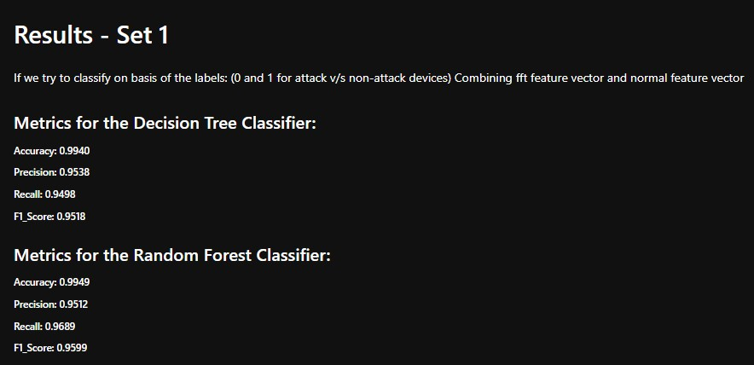
UNSW NB-15 Dataset (Network Intrusion) - Results
Model 1 : Using the entire dataset for Binary and Multiclass Classification

Slide 26
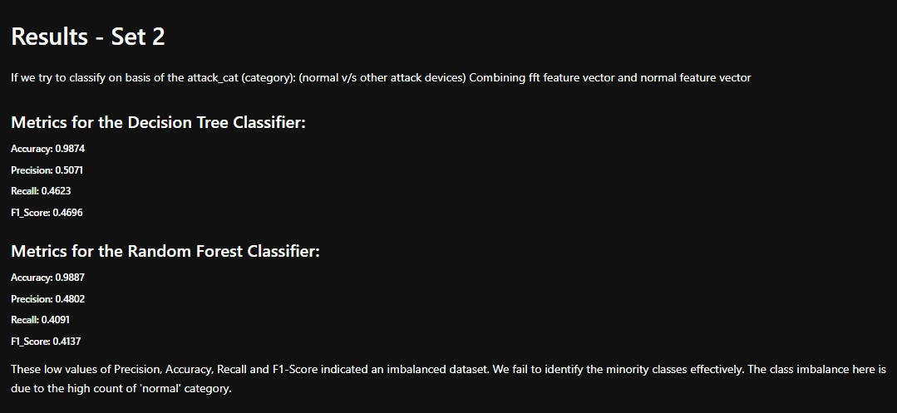
UNSW NB-15 Dataset (Network Intrusion) - Results
Model 1 : Using the entire dataset for Binary and Multiclass Classification

Slide 27
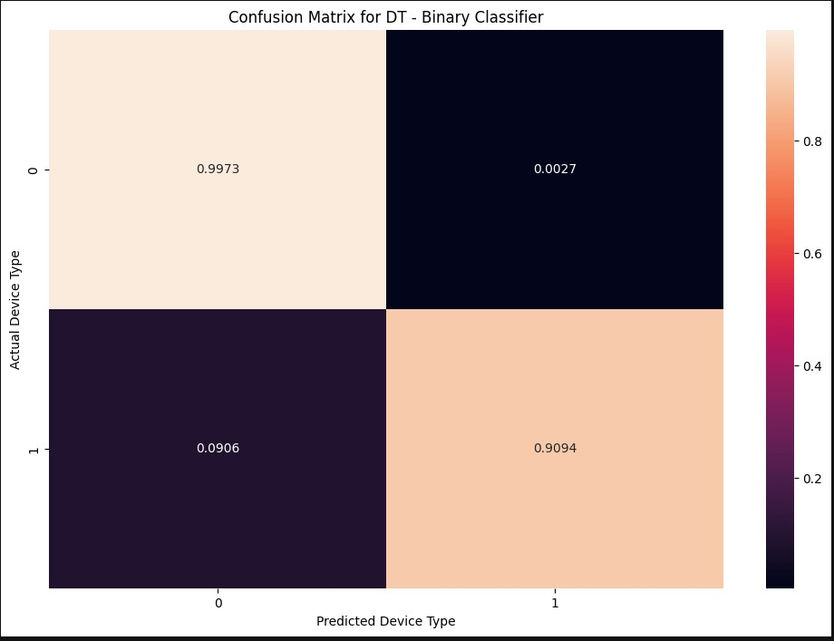
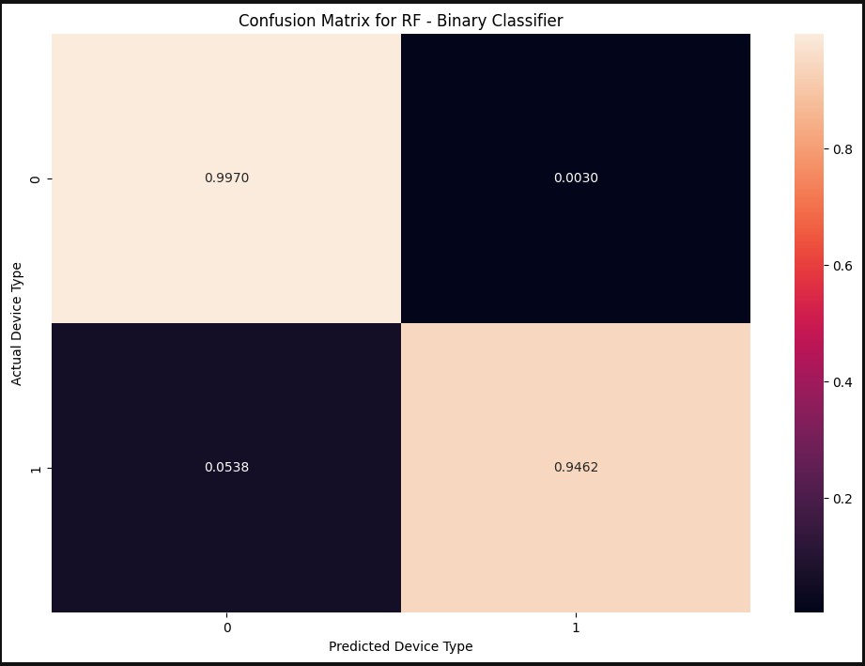
UNSW NB-15 Dataset (Network Intrusion) - Results
Model 1 : Using the entire dataset for Binary and Multiclass Classification

Slide 28
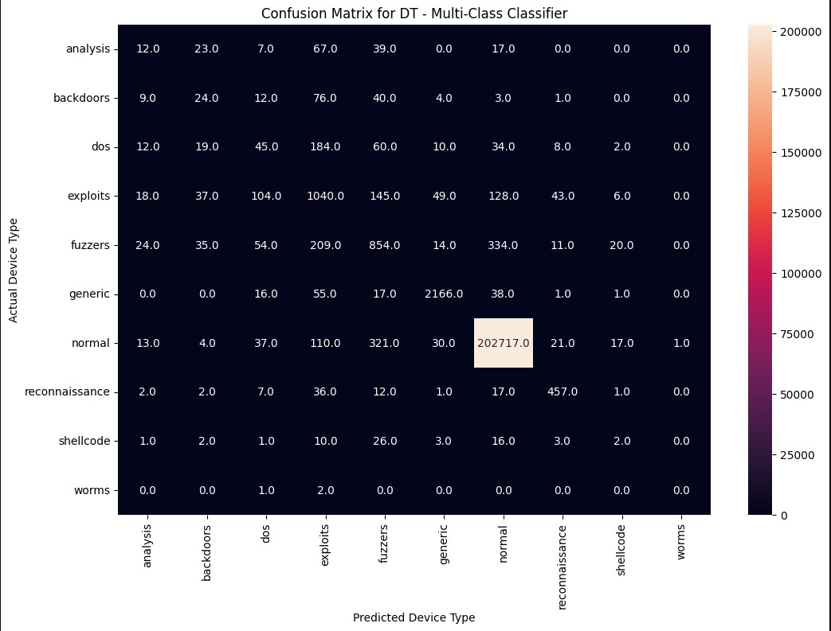

UNSW NB-15 Dataset (Network Intrusion) - Results
Model 1 : Using the entire dataset for Binary and Multiclass Classification

Slide 29
UNSW NB-15 Dataset (Network Intrusion)
Model 2 : Using the subsets of the entire Dataset for Binary Classification
Steps:
Systematically combined all the available csv files containing packet capture data to create a sufficiently large dataset as created earlier.
The dataset was subjected to data preprocessing, exploratory analysis, feature extraction, and Fourier Transformations. To add onto it, 9 separate dataset subsets were created to test the performance.
Using 2 ML Classifiers - Decision Tree and Random Forest, models were trained using a feature vector size of 11 and FFT was performed to increase the accuracy.
The training dataset consisted of partial data from attack devices while the testing data consisted of the entire partitioned dataset and all 10 devices (normal + abnormal).
Results were obtained at each step, when the training data included partial number of attack devices.
The model performed fairly well at each fold, and it was observed that the performance metrics gradually increased as the number of attack devices in the training dataset increased.

Slide 30
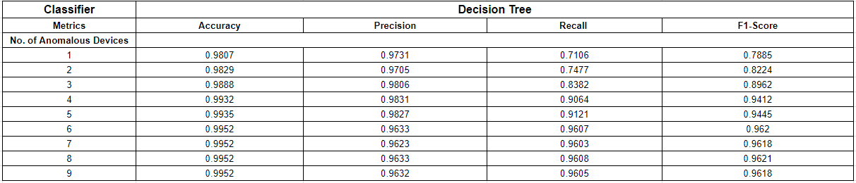
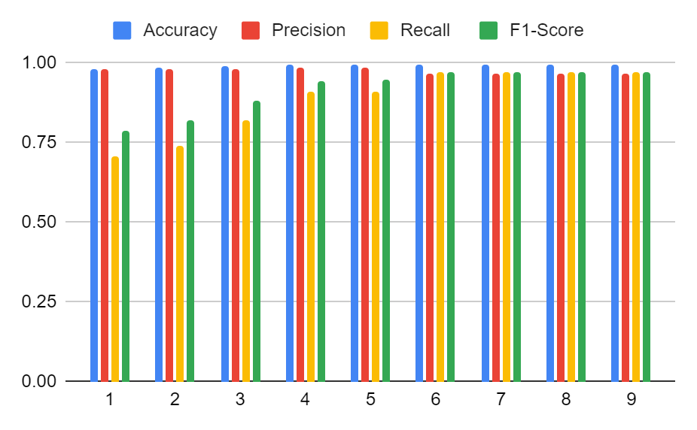
UNSW NB-15 Dataset (Network Intrusion)
Model 2 : Using the subsets of the entire Dataset for Binary Classification
It was observed that as the number of anomalous devices in the training dataset increased, all the performance metrics eventually increased. However, even in the absence of any anomalous device, very good results were observed.

Slide 31
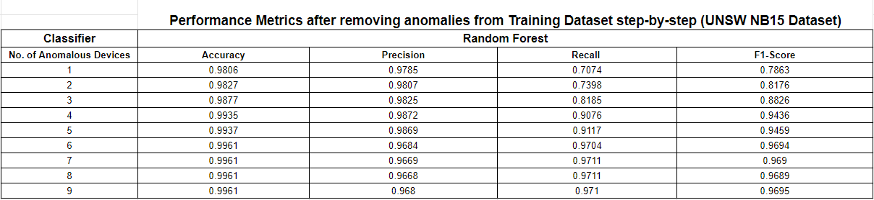
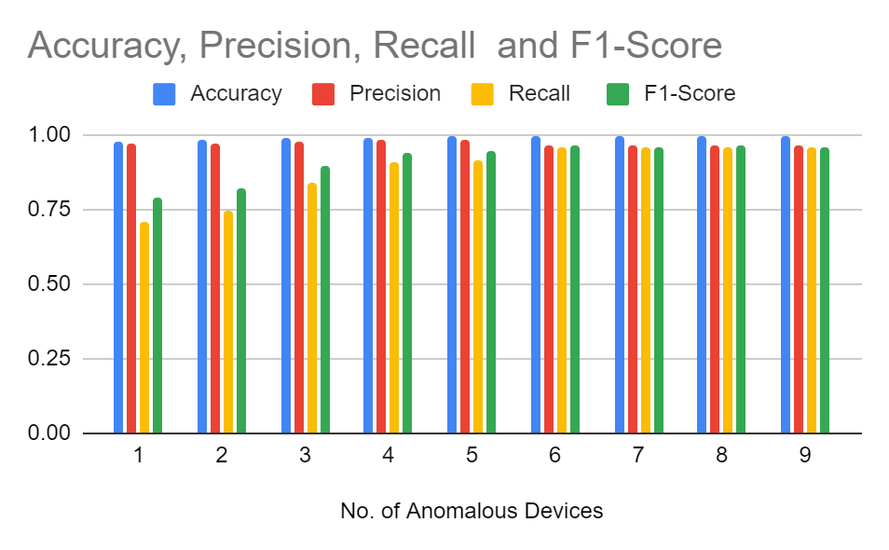
UNSW NB-15 Dataset (Network Intrusion)
Model 2 : Using the subsets of the entire Dataset for Binary Classification
It was observed that as the number of anomalous devices in the training dataset increased, all the performance metrics eventually increased. However, even in the absence of any anomalous device, very good results were observed.

Slide 32
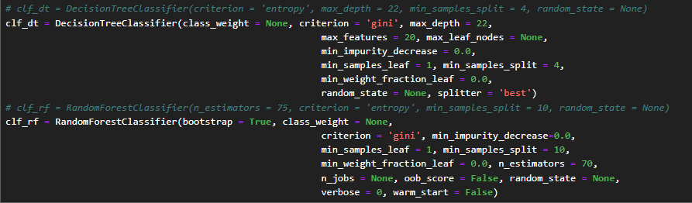
UNSW IoT Analytics Dataset (Traffic Traces)
Model 3 : Using FFT Model for Multi-Class Classification
For this dataset, I first combined the sample data from 4 days, to get the number of packets up to 25,00,000.
This data was not subjected to any resampling and was preprocessed.
The IoT Analytics dataset contained very few numerical features - Packet size (‘Size’) and Port Destination and Source (port.src, port.dst).
The labels were provided in the form of MAC Addresses of 29 devices (including IoT and Smart Devices)
FFT was performed on the numeric values, and concatenated with the actual network traffic features to provide enhanced results since the FFT tends to capture frequency domain patterns.
The classifier hyperparameters were tuned the same way as the previous ones since they tend to provide the best accuracy.

Slide 33
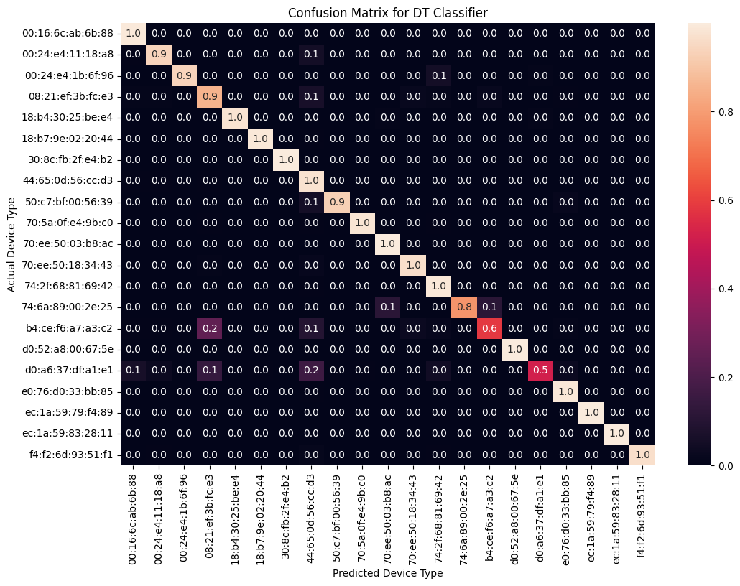

UNSW IoT Analytics Dataset (Traffic Traces) - Results
Model 3 : Using FFT Model for Multi-Class Classification

Slide 34


UNSW IoT Analytics Dataset (Traffic Traces) - Results
Model 3 : Using FFT Model for Multi-Class Classification

Slide 35
test.csv - Sampled Dataset
Model 4 : Using FFT Model for Multi-Class Classification
This Dataset contains 80,000 packets from 8 separate devices. (10k packets each)
It has been sampled, and was used to provide a benchmark for the results of other open-source datasets.
Due to the lack of any temporal features (random sampling), it is difficult to perform time-domain analysis on this dataset.
Due to this absence of any seasonality, the models were performing quite poorly.
As a result, I used the stacking approach to increase the performance of the dataset.
Stacking: Involves splitting a data set up into smaller data sets, and stacking the values for each of the variables into a single column.
This process enhances the feature set size, yielding much better results. Stacking was implemented and used in the test_5.csv file.

Slide 36

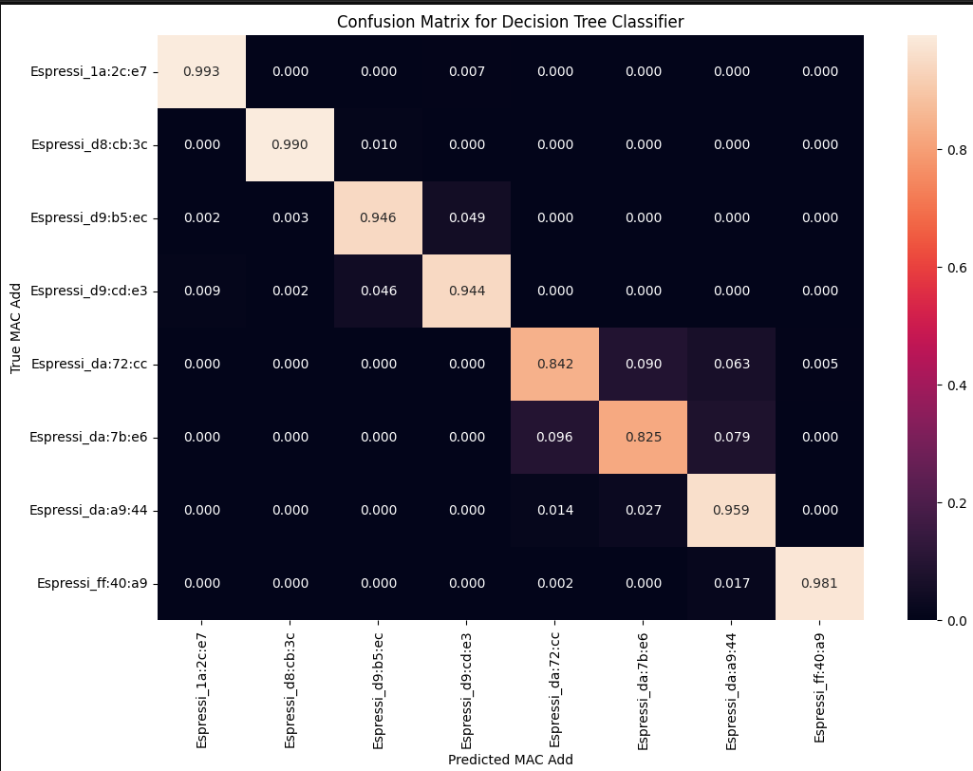


test_5.csv - Sampled Dataset
Model 4 : Using FFT Model for Multi-Class Classification

Slide 37
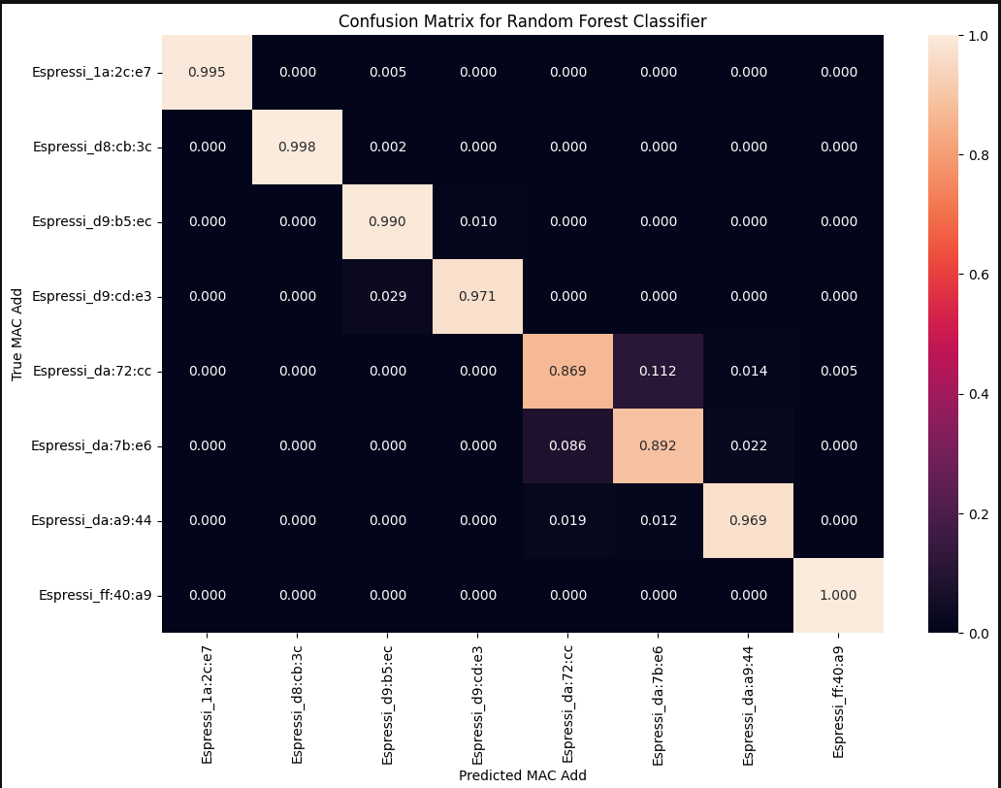


test_5.csv - Sampled Dataset
Model 4 : Using FFT Model for Multi-Class Classification

Slide 38
test_5.csv - Sampled Dataset
Model 4 : Using FFT Model for Multi-Class Classification
It is observed that there is significant increase in the performance metrics of the classifiers due to the stacking technique.
However, sampled data should not be used since it will give us false results. When actual data is captured, the packets will never be captured in the same quantity per device.
Hence, we can rely on the 3 Models that were previously showcased in the presentation.

Slide 39
Results and Conclusion
Targets achieved:
Combining Hardware-level patterns using network-traffic data to enhance the performance of classification models.
Testing the models on open-source datasets (UNSW and IoT Sentinel) and obtaining definitive results.
Relying on ML Classifiers and obtaining really good accuracy for all models, when compared with the small feature vector. (The feature vector size of CNN Classifiers is very large and model is heavy)
Performing Binary Classification on the UNSW - NB15 dataset to provide effective anomaly detection using FFT and combining it with traditional network-traffic analysis.
Training 4 separate models with requirements specific to the dataset.
Challenges faced:
The dataset on UNSW Traffic Traces contained only the packet-size as the numeric feature through which we could try to capture frequency-domain patterns. Hence, datasets need to capture important features like inter-packet arrival time (for temporal analysis) etc.
Improving the accuracy of the ML models further seems difficult, but CNN’s can be implemented for the same.

